Slide 1
A-Level Taster Task

Slide 2
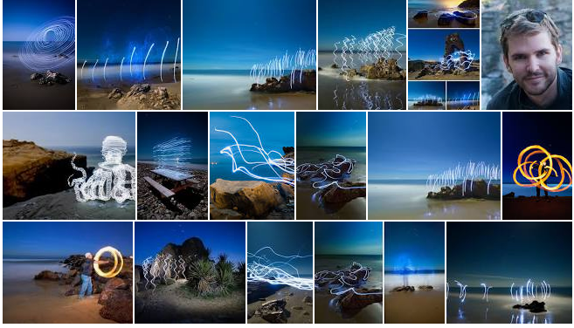
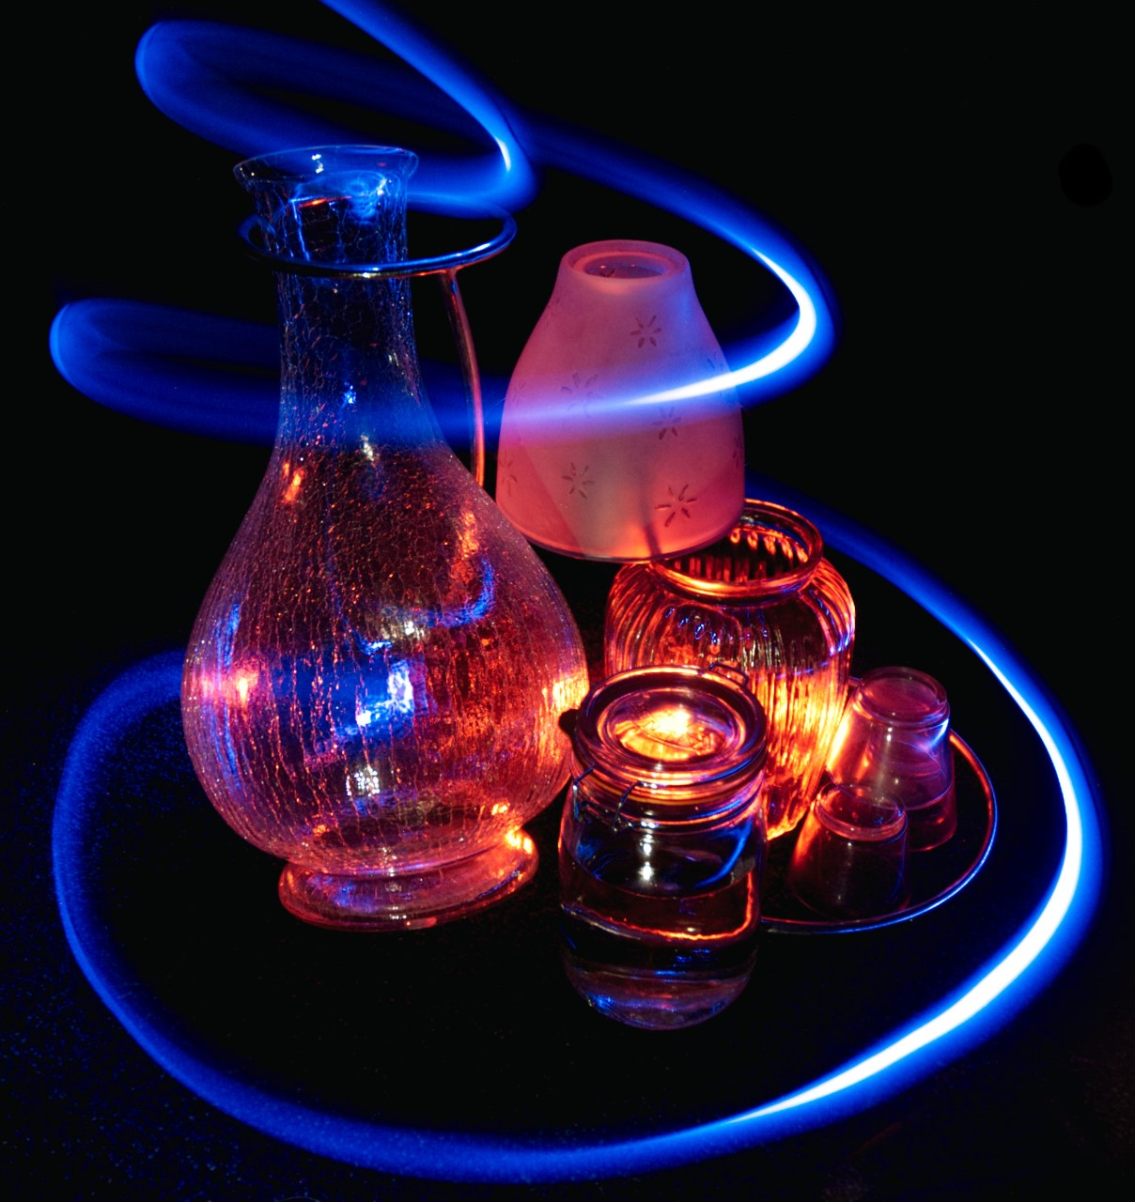
Toby Keller
The A-level photography course is similar to the GSCE Art and Design course. Your projects will start with a designer you like which will influence the work you do in the future. For this taster session do research on Toby Keller (or one of your own) and present the work on an A3 sheet like the examples shown on the other slides. Slide 10 has the task in more detail.

Slide 3
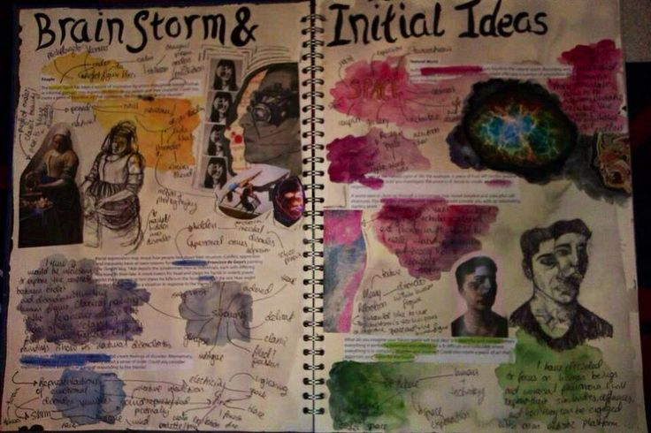
Designer Research - Layout
Look at this sketchbook. What do you think the student has done well, and what have they done wrong?

Slide 4
Artist Research
Success Criteria:
Stick in examples of your chosen photographers work
Add factual research on your photographer
Create an in depth analysis of a picture.

Slide 5
Designer Research - I.D.E.A
Identify: List artist name, year of birth (and death), name of work and date completed if known. Relevant information about the artist.
Describe: why the artwork links to your project. How can you link your work to the art piece? Mood, style etc. Be specific!
Explain: what is happening in the artwork? What formal elements have been used and how does this make the artwork look. What is the mood of the work? What was the artist trying to achieve?
Analyse: why you chose this artist, what do you like about their work? What elements of their work will you explore? The style, lighting, subject etc.

Slide 6
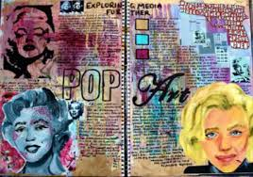

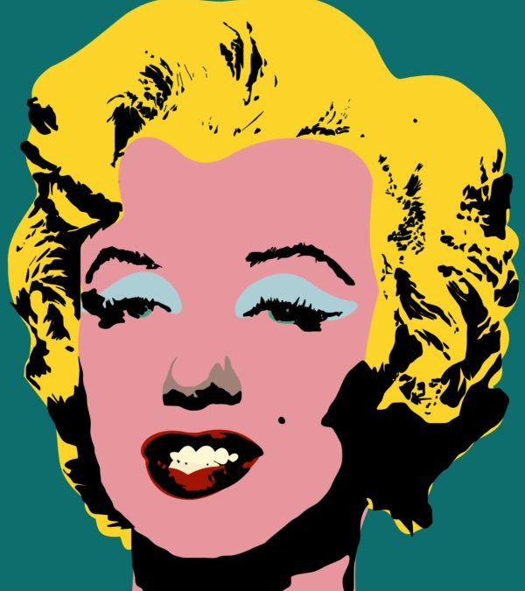
Designer Research - Layout
The style of your layout needs to reflect the artist you have chosen.
Pop art is about using bright colours and clean lines. This student has not presented their work on Pop art in the same way. This demonstrated understanding of their sources.
The messy style of this style does not highlight the work of the student.

Slide 7
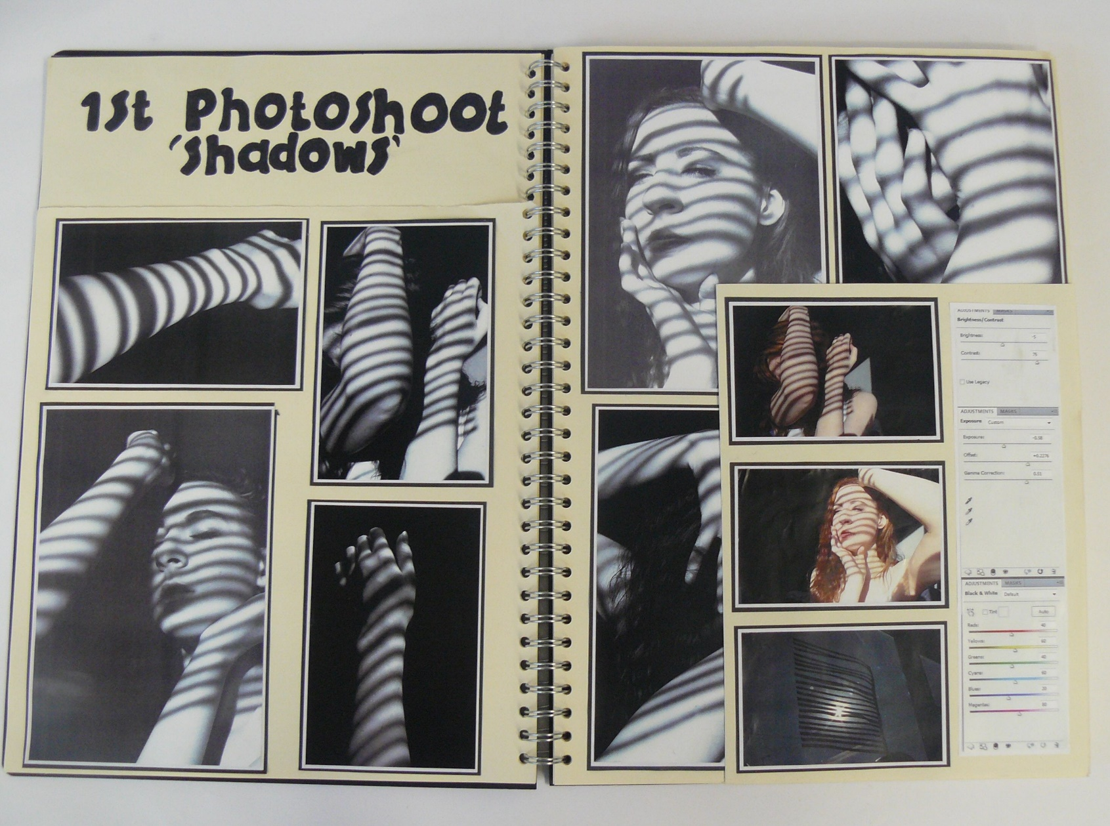
Designer Research - Layout
Clear Title
Neat borders
Good use of space.

Slide 8
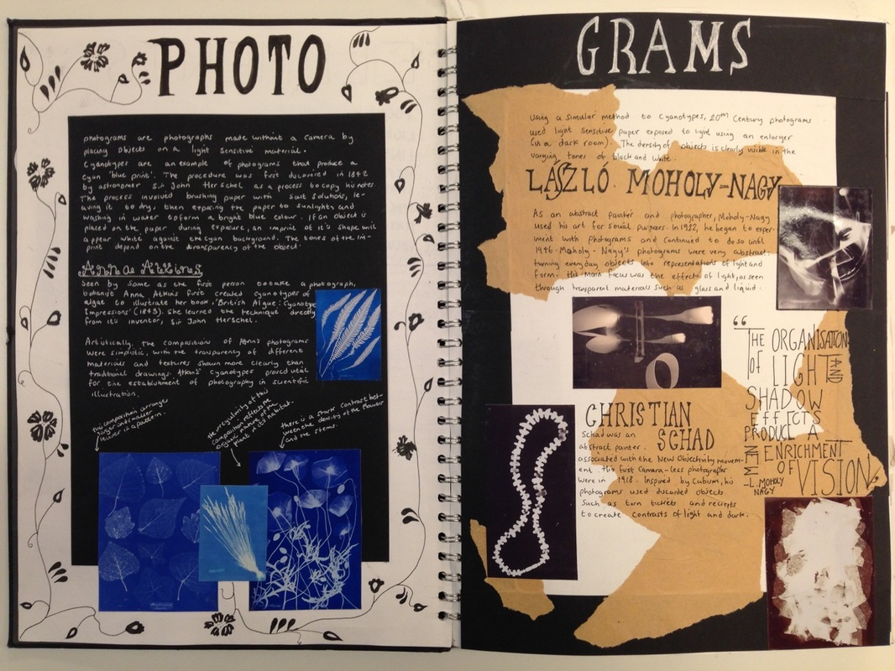
Designer Research - Layout
You can make your page look interesting, but your work and images should be the main focus.

Slide 9
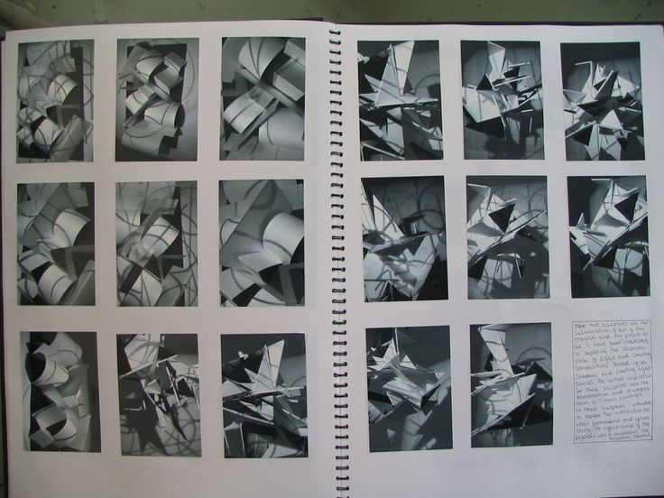
Designer Research - Layout

Slide 10
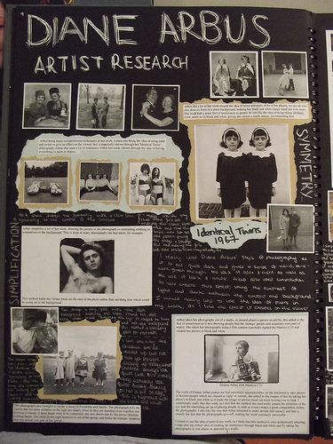
What do you need to include?
Images of the artist’s work (3-5)
A bit of background information on the Artist.
A description of the artists photographs.
Your own thoughts/opinions about the artist’s work
Top Tips
Write out your annotation first, then copy it into your books
If you have messy handwriting, type up your analysis/annotation
Check spelling and grammar carefully (you will be marked on this!)
Use the I.D.E.A sheet to help you!

